Slide 1
Women Leaders in Troubled Times:
Gender & the Corona Pandemic
Prof. Joyce Marie Mushaben

Slide 3
Gendered Leadership Stereotypes
Personal traits ascribed to women:
** attractive (or not), cooperative, demur, emotional, gentle, helpful, kind, nurturing, peace-loving, quiet, relationship-oriented, risk-averse, sensitive, subordinate, sympathetic and warm.
Personal traits ascribed to men:
** aggressive, ambitious, competitive, controlling, daring, dominant, forceful, independent, loud, rational, rule-oriented, self-confident, visionary and inclined towards war-mongering.
These attributes say more about (perceived) STYLES than about real QUALIFICATIONS, negotiating SKILLS, effective PERFORMANCE and POLICY OUTCOMES.

Slide 4
Leadership Styles : Transactional Model
foresees a manager who commands behavioral compliance from employees;
relies heavily on punishment (“you’re fired”) and rewards to influence employee performance;
applies a “command and control” style, based on hierarchical structures, organizational loyalty, narrow objectives and clear lines of authority;
pay close attention to employees’ mistakes but evince little concern for personal circumstances or work-place conditions (e.g., sexual harassment) that might hinder their effective performance.
hierarchical division of labor fosters hands-off approach (allowing leader toshift the blame for poor performance), until crisis conditions require a form of heroic, personalized decision-making.
The transactional type was popularized by Robert Dahl, who characterized leadership as “A’s job to make B do what s/he would not ordinarily do.”

Slide 5
Leadership Styles : Transformational Model
stimulates colleagues/followers to view their work from a new perspective.
generates an awareness of the institutional mission, urging colleagues to realize their own potential
helps coworkers to looking beyond their own interests to benefit the common good;
cultivates stakeholders by fostering participation and promote empathy, trust and respect.
rejects commands in favor of team-work, “plain speaking” and partnership
replaces “authority” defined in terms of rungs on a power-ladder with shared values and pragmatic expertise.
As understood by Mary Parker Follett, “leadership is not defined by the exercise of power but by the capacity to increase the sense of power among those led. The most essential work of the leader is to create more leaders.”

Slide 6
Emotional Intelligence
“the ability to monitor one's own and others' feelings…, and to use this information to guide one's actions.”
does not mean taking everything personally; rests on self-control, self-confidence, the ability to handle conflict, and tolerance for stress.
empathizes with her constituents, often stressing in speeches how “hard” certain decisions have been;
communicates in terms easily understood by average citizens, using everyday metaphors.
utilizes “soft skills”: listening, mediation, discretion
pursues transparency, openly admitting mistakes and lessons learned.

Slide 7
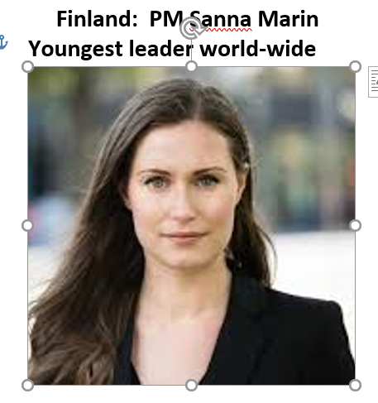
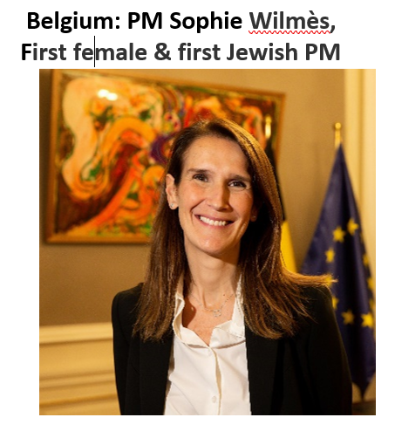
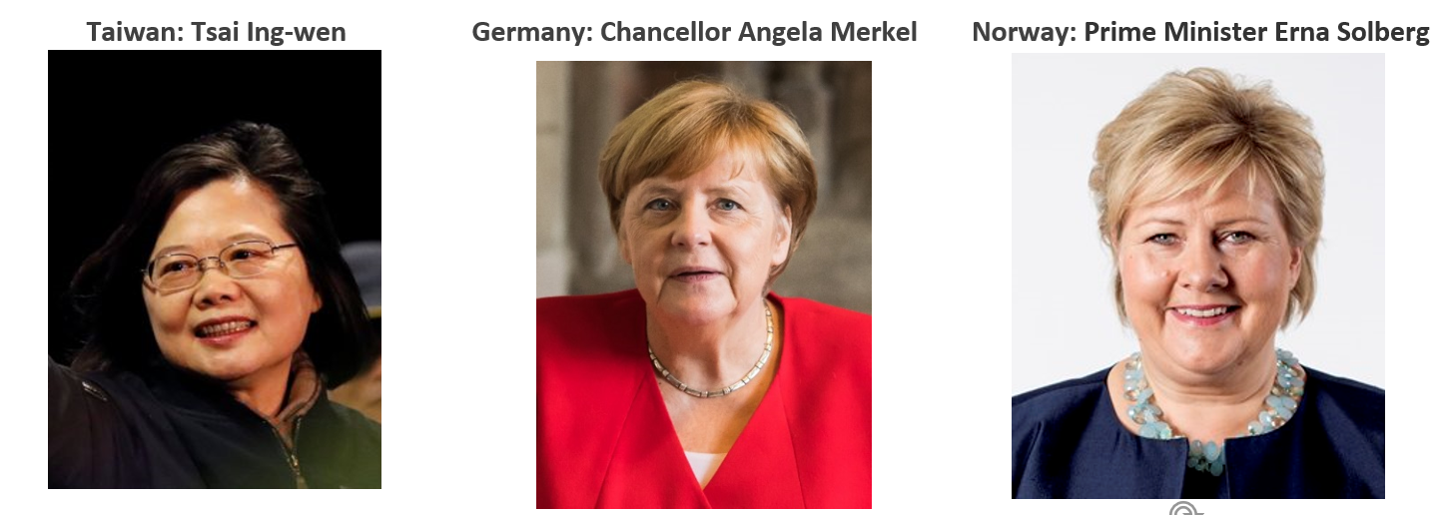
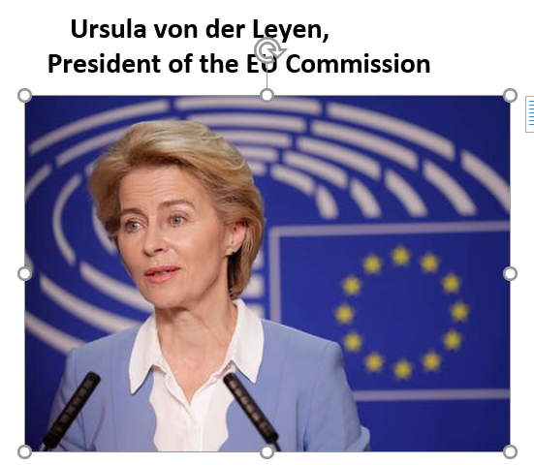
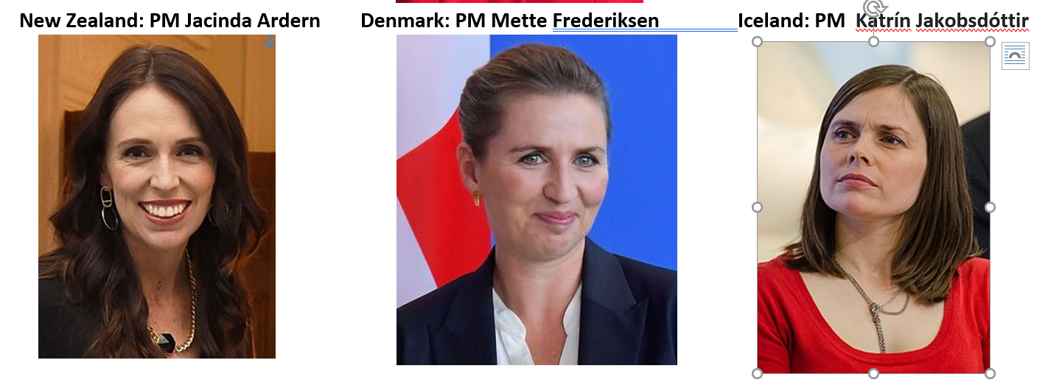
Calling the shots…

Slide 8
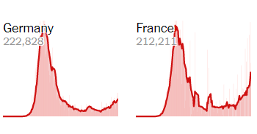
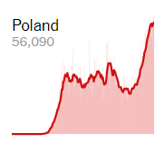
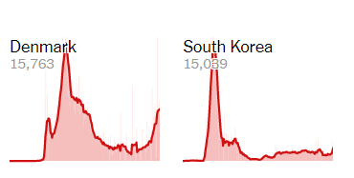
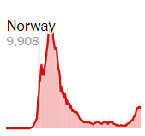
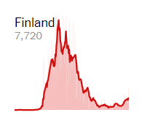
Global
Outbreaks
Country Counts

Slide 9
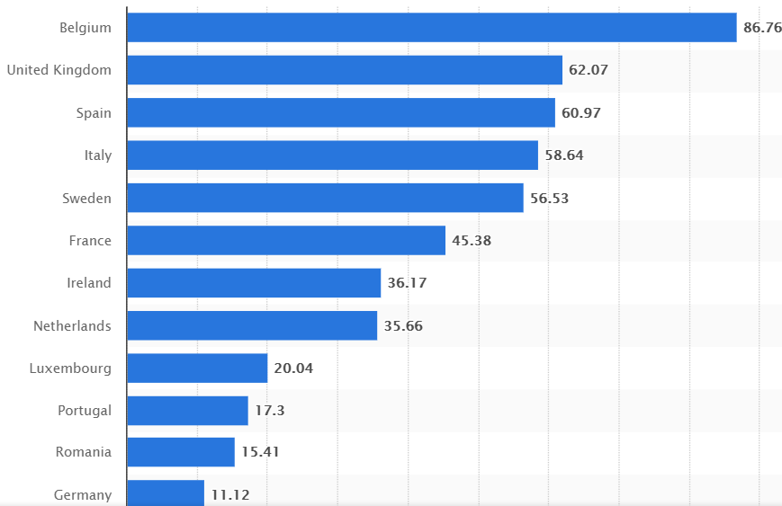
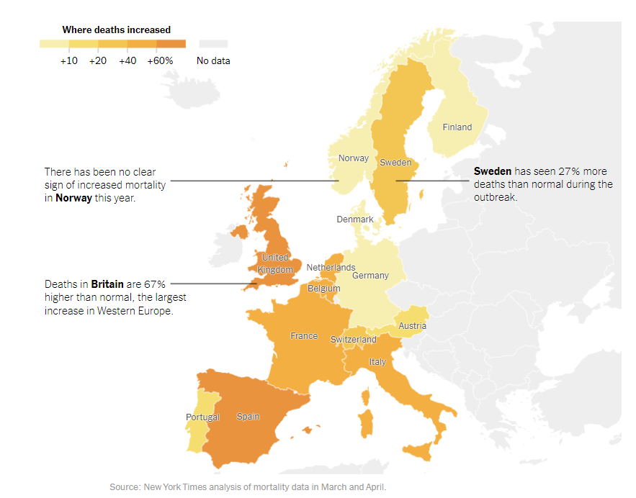
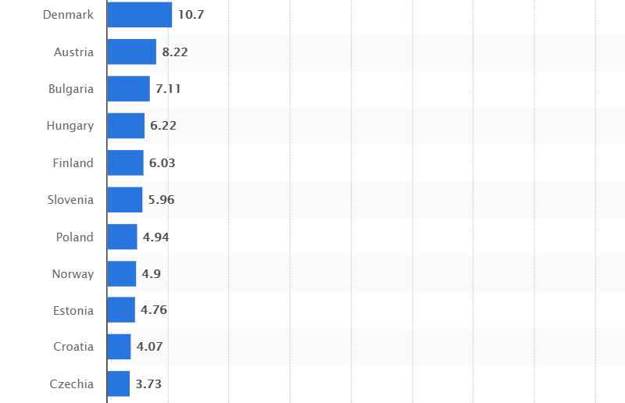
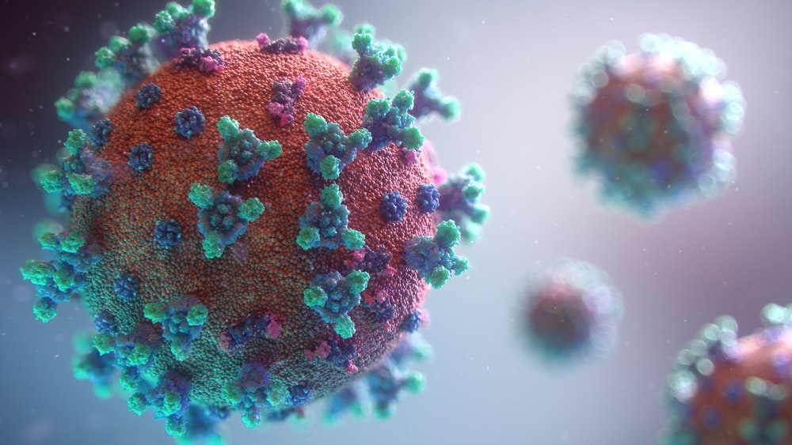
Corona Mortality rates across Europe

Slide 10
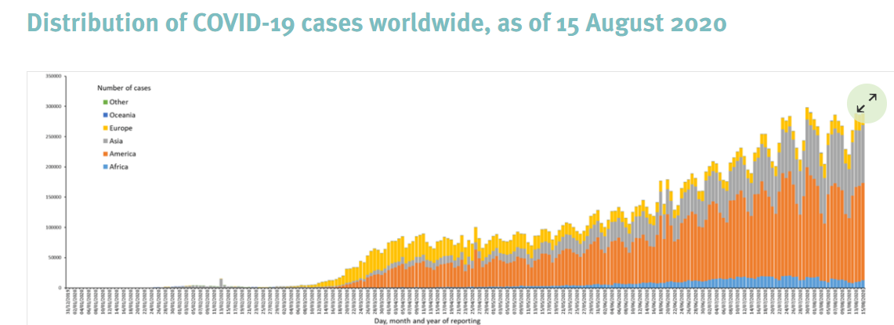
https://www.ecdc.europa.eu/en/current-risk-assessment-novel-coronavirus-situation: Distribution of COVID-19 cases, 15 August 2020

Slide 11
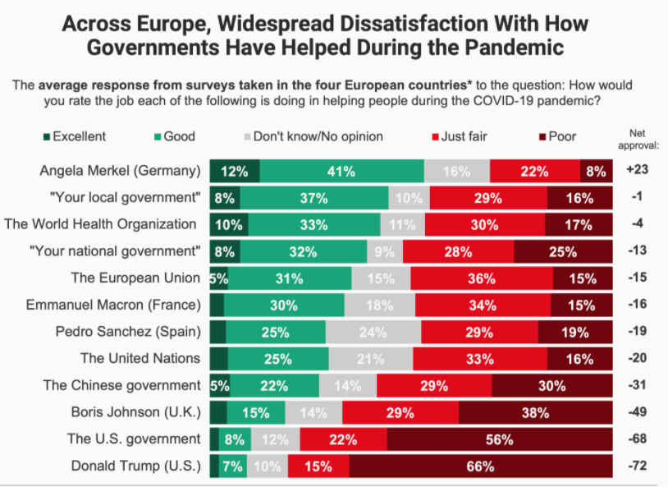

Slide 12
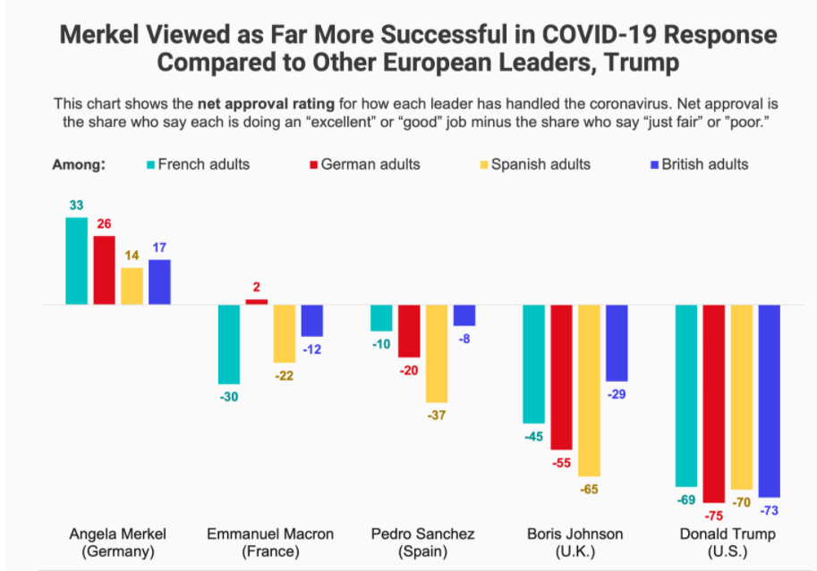
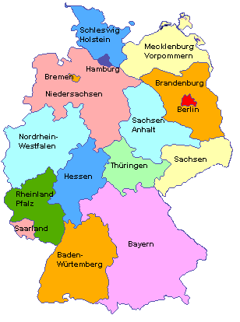

Slide 13
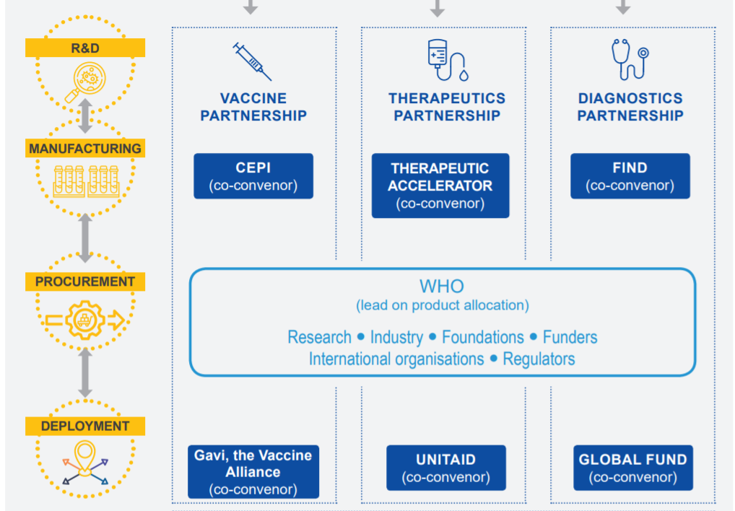
“ACT” - ACCELERATOR GLOBAL RESPONSE TO COVID-19 (Von der Leyen)

Slide 14
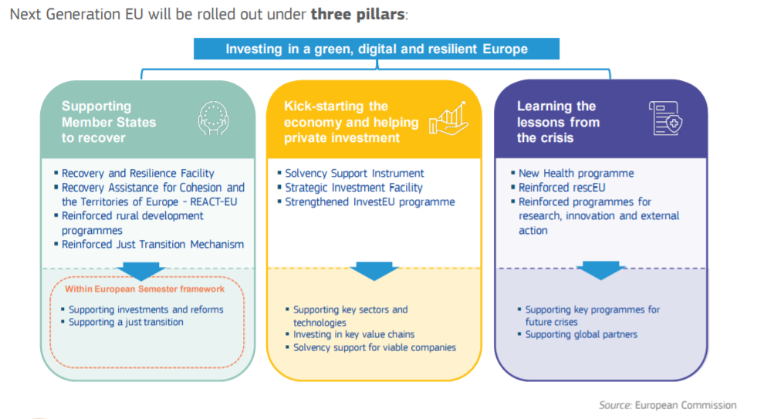
“Next Generation EU”: three pillars

Slide 15
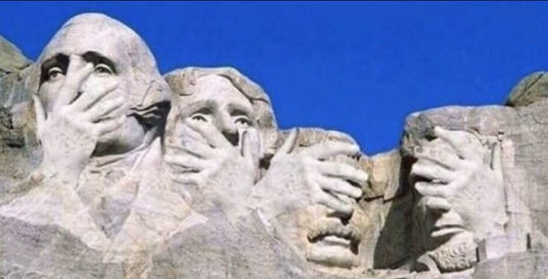
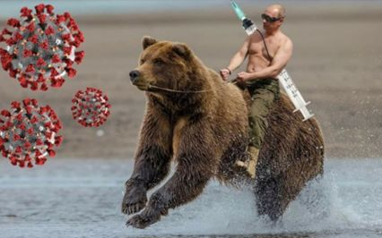
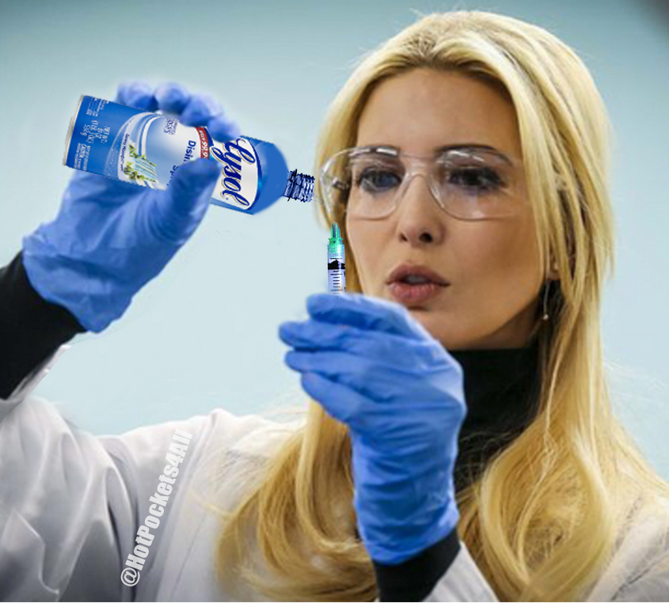
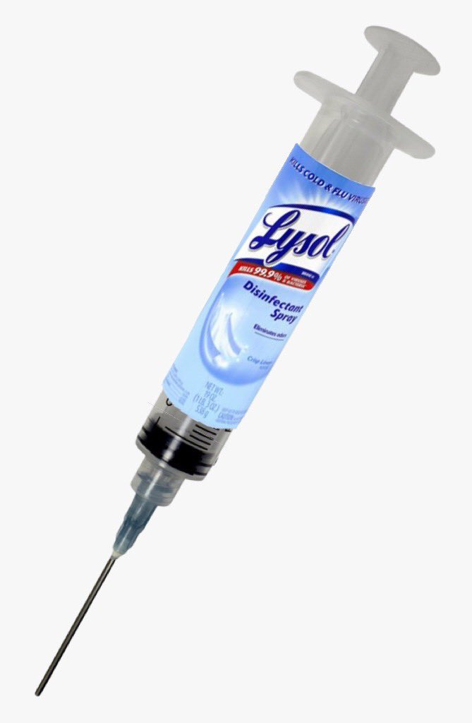
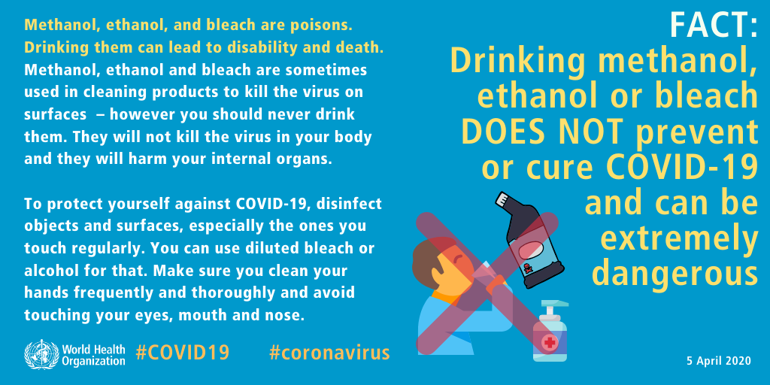
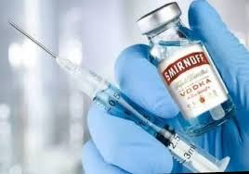

Slide 16
